Slide 1
Brief review of the material so far
Recursive procedures, recursive data structures
  Pseudocode for algorithms
    Example: algorithm(s) to compute a^{n}
    Example: merge sort
    Example: Tree properties
  Use of induction to prove / determine
    Correctness
    Complexity
    Techniques to remember:
      Structural induction
      Recursion and induction
  Trees

Slide 2
Exercise
Use induction to prove that the number of nodes in a binary tree is at most 2^{h(T)+1}-1 where h(T) is the height of the tree.

Slide 3
Discrete Structures & Algorithms
Efficient data structures and algorithms
(Red-black trees)

Slide 4
A binary search tree (BST) is a binary tree with the following properties:
  The key of a node is always greater than the keys of the nodes in its left subtree.
  The key of a node is always smaller than the keys of the nodes in its right subtree.

Slide 5
Binary search trees
Stored keys must satisfy the binary search tree property.
  ∀ y in left subtree of x, then key[y] ≤ key[x].
  ∀ y in right subtree of x, then key[y] ≥ key[x].
56
26
200
18
28
190
213
12
24
27

Slide 6
Height of a binary tree
Most BST operations have a time complexity that is related to the height of the tree.
At worst, can be n, where n is the total number of nodes.

Slide 7
A full binary tree
If, for a tree of height h, all levels are full.
  All nodes at height (or depth) h are leaf nodes.
How many nodes exist in a full binary tree of height h?

Slide 8
A full binary tree
Theorem: A full BST of height h has 2^{h} - 1 nodes
Proof:
Use induction.
Inductive Basis: A tree of height 1 has one node (the root).
Inductive Hypothesis: Assume that a tree of height h has 2^{h} - 1 nodes. …

Slide 9
A full binary tree
Inductive step: Connect two trees of height h to make one of height h+1.
You need to add one more node for the new root.
root
h+1
h
L
R
By the inductive hypothesis, the new number of nodes is (2^{h} - 1) + (2^{h} - 1) + 1 = 2^{h+1} - 1 … proved!

Slide 10
Minimum height of a binary tree
We saw that a full binary tree of height h has n=2^{h}-1 nodes.
Given n keys (values), what is the smallest height of a binary tree that can store these n keys?
  h_{min} = 1+⎣log₂n⎦
    for any real number x, ⎣x⎦ is the largest integer smaller than or equal to x.
    Similarly, ⎡x⎤ is the smallest integer greater than or equal to x.
  Prove as an exercise.

Slide 11
Complete binary trees
A complete binary tree (of height h) satisfies the following conditions:
  Level 0 to h-1 represent a full binary tree of height h.
  One or more nodes in level h-1 may have 0, or 1 child nodes.
  If j, k are nodes in level h-1, then j has more child nodes than k if and only if j is to the left of k.

Slide 12
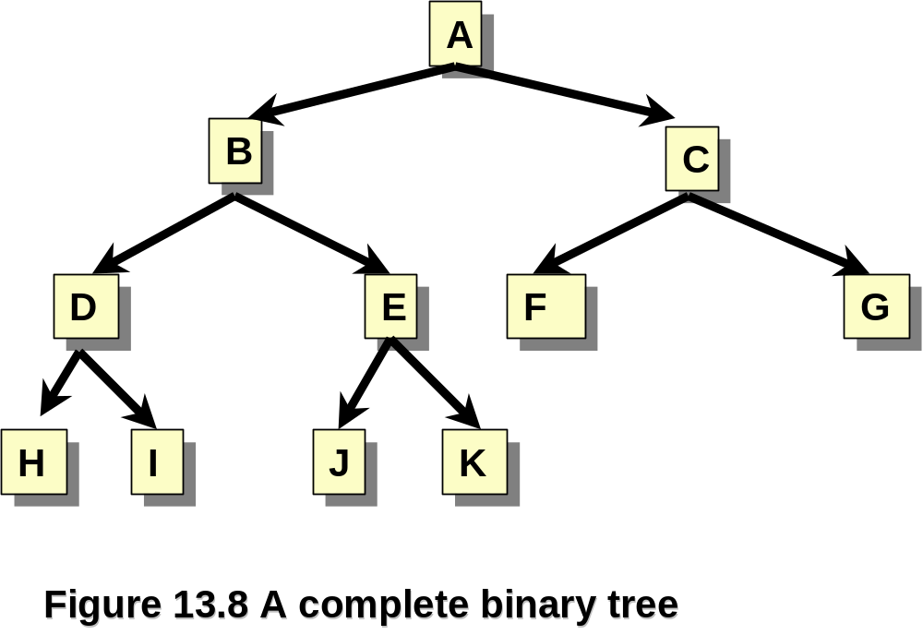
A complete binary tree

Slide 13
Complete binary trees
Given a set of n nodes, a complete binary tree of these nodes provides the maximum number of leaves with the minimal average path length (per node).
The complete binary tree containing n nodes must have at least one path from root to leaf of length ⎣log n⎦.

Slide 14
Height-balanced binary trees
A height-balanced binary tree is a binary tree such that:
  The left and right subtrees for any given node differ in height by no more than one.
Note: A complete binary tree is height-balanced

Slide 15
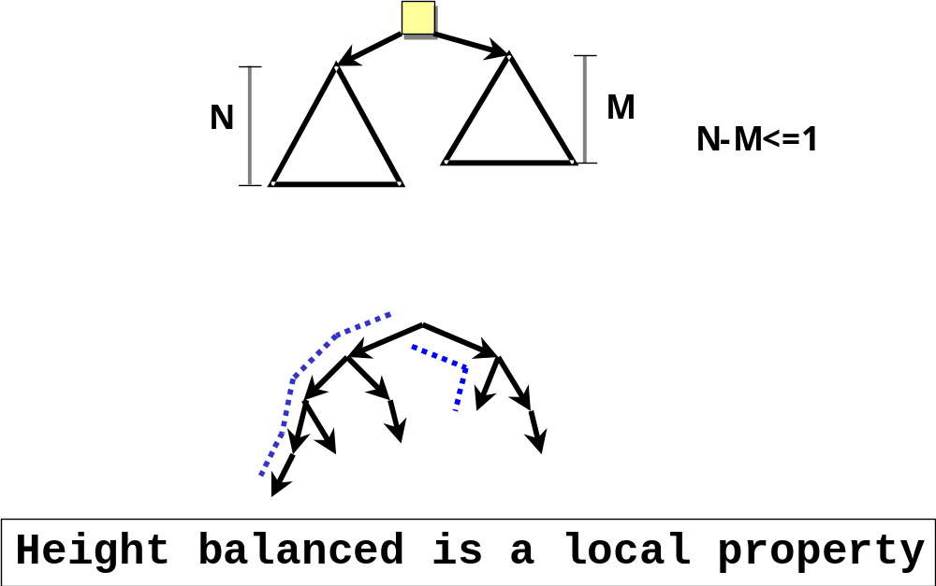
Height-balanced binary trees

Slide 16
Time complexity of BST operations
All dynamic-set search operations can be supported in O(h) time.
h = Θ(lg n) for a balanced binary tree (and for an average tree built by adding nodes in random order.)
h = Θ(n) for an unbalanced tree that resembles a linear chain of n nodes in the worst case.
→ It is better to keep the tree balanced.

Slide 17
Building a BST
Is there a unique BST for letters A B C L M ?
No! Different input sequences result in different trees.
Therefore, we may need to explicitly balance a tree.
Inserting: A B C L M
Inserting: C A B L M
A
B
C
C
L
A
L
B
M
M

Slide 18
Keeping the height of a BST small improves the running time of algorithms on the tree.

Slide 19
Red-black trees
“Balanced” binary trees guarantee an O(lg n) running time on the basic dynamic-set operations.
Red-black tree
  Binary tree with an additional attribute for its nodes: color which can be red or black.
  Constrains the way nodes can be colored on any path from the root to a leaf.
    Ensures that no path is more than twice as long as another ⇒ the tree is ‘balanced’.
  The nodes inherit all the other attributes from the binary search trees: key, left, right, p.

Slide 20
Red-black trees
A binary search tree where:
Every node is either red or black.
The root is black.
Every leaf (NIL) is black.
If a node is red, then both its children are black.
  No two red nodes in a row on a simple path from the root to a leaf.
For each node, all paths from the node to descendant leaves contain the same number of black nodes.

Slide 21
Example: RED-BLACK TREE
26
17
41
NIL
NIL
30
47
38
NIL
50
NIL
NIL
NIL
NIL
NIL
For convenience we use a sentinel NIL[T] to represent all the NIL nodes at the leafs
  NIL[T] has the same fields as an ordinary node
  Color[NIL[T]] = BLACK
  The other fields may be set to arbitrary values

Slide 22
‘Black-height’ of a node
h = 4
bh = 2
26
h = 1
bh = 1
h = 3
bh = 2
17
41
NIL
NIL
h = 2
bh = 1
h = 2
bh = 1
30
47
h = 1
bh = 1
38
50
h = 1
bh = 1
NIL
NIL
NIL
NIL
NIL
NIL
Height of a node: the number of edges in a longest path to a leaf
Black-height of a node x: bh(x) is the number of black nodes (including NIL) on the path from x to leaf, not counting x.

Slide 23
Properties of red-black trees (1)
Claim
  Any node with height h has black-height >= h/2.
Proof
  By property 4, at most h/2 red nodes on the path from the node to a leaf.
  Hence at least h/2 are black.
26
17
41
30
47
  Property 4: if a node is red then both its children are black.
38
50

Slide 24
Properties of red-black trees (2)
Claim: The subtree rooted at any node x contains at least 2^{bh(x)} - 1 internal nodes.
Proof: By induction on height of x.
Basis: height[x] = 0 ⇒
x is a leaf (NIL[T]) ⇒
bh(x) = 0 ⇒
# of internal nodes: 2⁰ - 1 = 0
x
NIL

Slide 25
Properties of red-black trees (2.cont)
Inductive step:
Let height(x) = h and bh(x) = b.
Any child y of x has:
  bh (y) =
  bh (y) =
b (if the child is red), or
b - 1 (if the child is black)
26
17
41
30
47
38
50

Slide 26
Properties of red-black trees (2.cont)
Want to prove:
  The subtree rooted at any node x contains at least 2^{bh(x)} - 1 internal nodes.
Internal nodes for each child of x:
2^{bh(x) - 1} - 1. [induction hypothesis]
The subtree rooted at x contains at least:
(2^{bh(x) - 1} – 1) + (2^{bh(x) - 1} – 1) + 1 =
2 · (2^{bh(x) - 1} - 1) + 1 =
2^{bh(x)} - 1 internal nodes.
x
l
r

Slide 27
Properties of red-black trees (3)
Lemma: A red-black tree with n internal nodes has height at most 2 lg(n + 1).
Proof:
n
Add 1 to both sides and then take logs:
n + 1 ≥ 2^{b} ≥ 2^{h/2}
lg(n + 1) ≥ h/2 ⇒
h ≤ 2 lg(n + 1)
height(root) = h
root
bh(root) = b
≥ 2^{b} - 1
≥ 2^{h/2} - 1
l
r
number n
of internal
nodes
since b ≥ h/2

Slide 28
Operations on red-black trees
The non-modifying binary-search-tree operations MINIMUM, MAXIMUM, SUCCESSOR, PREDECESSOR, and SEARCH run in O(h) time.
  They take O(lg n) time on red-black trees.
What about TREE-INSERT and TREE-DELETE?
  They will still run on O(lg n).
  We have to guarantee that the modified tree will still be a red-black tree.

Slide 29
INSERT
INSERT: How do we colour the new node?
Red? Let’s insert 35.
  Property 4 violated: if a node is red, then both its children are black.
Black? Let’s insert 14.
  Property 5 violated: all paths from a node to its leaves contain the same number of black nodes.
26
17
41
30
47
38
50

Slide 30
DELETE
26
17
41
30
47
DELETE: What color was the
node that was removed? Black?
Every node is either red or black.
The root is black.
Every leaf (NIL) is black.
If a node is red, then both its children are black.
For each node, all paths from the node to descendant leaves contain the same number of black nodes.
38
50
OK!
Not OK! If removing the root and the child that replaces it is red.
OK!
Not OK! Could change the
black heights of some nodes.
Not OK! Could create
two red nodes in a row.

Slide 31
Rotations
Operations for restructuring the tree after insert and delete operations on red-black trees.
Rotations take an (almost) red-black-tree and a node within the tree and:
  Together with some node re-coloring they help restore the red-black-tree property.
  Change some of the pointer structure.
  Do not change the binary-search tree property.
Two types of rotations:
  Left & right rotations.

Slide 32
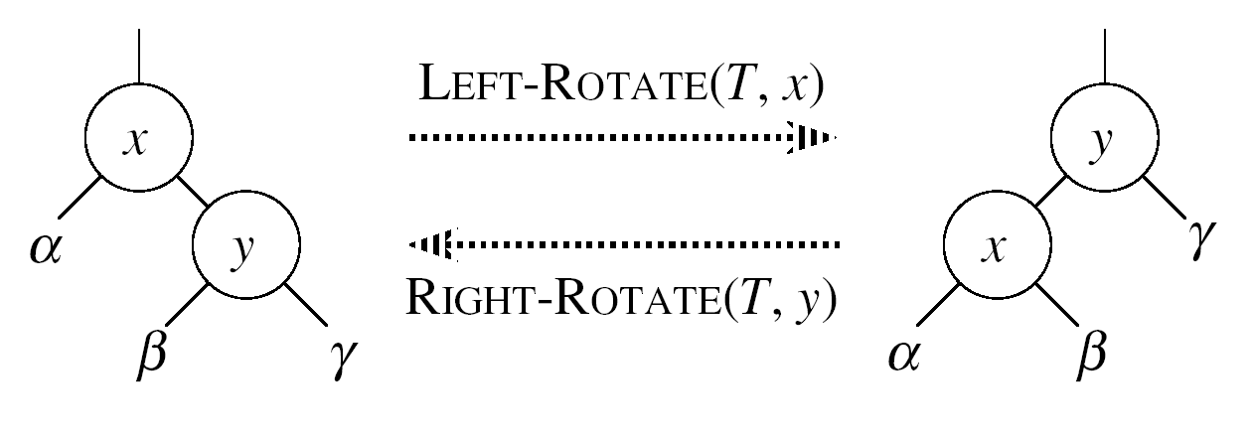
Left rotations
Assumptions for a left rotation on a node x:
  The right child of x (denoted y) is not NIL;
  Root’s parent is NIL.
Idea:
  Pivots around the link from x to y;
  Makes y the new root of the subtree;
  x becomes y’s left child;
  y’s left child becomes x’s right child.

Slide 33
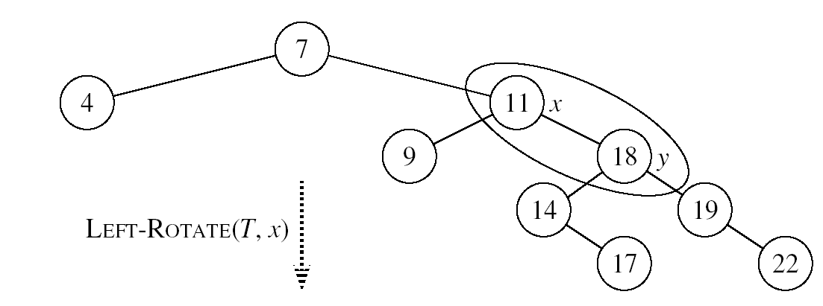
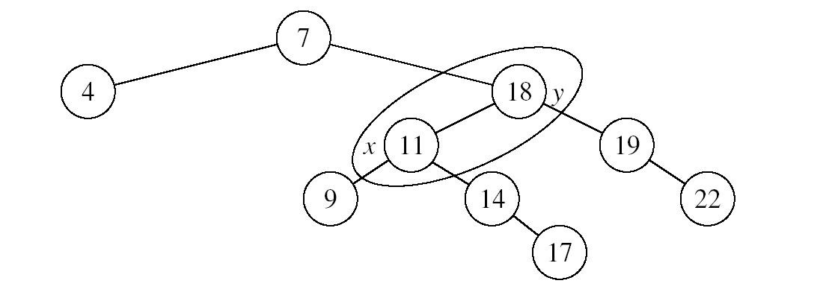
Example: LEFT-ROTATE

Slide 34
LEFT-ROTATE(T, x)
y ← right[x] ►Set y
right[x] ← left[y] ► y’s left subtree becomes x’s right subtree
if left[y] ≠ NIL
then p[left[y]] ← x ► Set the parent relation from left[y] to x
p[y] ← p[x] ► The parent of x becomes the parent of y
if p[x] = NIL
then root[T] ← y
else if x = left[p[x]]
then left[p[x]] ← y
else right[p[x]] ← y
left[y] ← x ► Put x on y’s left
p[x] ← y ► y becomes x’s parent

Slide 35
Right rotations

Slide 36
Insertion
Goal:
  Insert a new node z into a red-black-tree.
Idea:
  Insert node z into the tree as for an ordinary binary search tree;
  Color the node red;
  Restore the red-black-tree properties.
    Use an auxiliary procedure RB-INSERT-FIXUP.

Slide 37
RB-INSERT(T, z)
26
17
41
30
47
y ← NIL
x ← root[T]
while x ≠ NIL
do y ← x
if key[z] < key[x]
then x ← left[x]
else x ← right[x]
p[z] ← y
38
50
Initialize nodes x and y
Throughout the algorithm y points
to the parent of x.
Go down the tree until
reaching a leaf;
At that point y is the
parent of the node to be
Inserted.
Sets the parent of z to be y

Slide 38
RB-INSERT(T, z)
26
17
41
if y = NIL
then root[T] ← z
else if key[z] < key[y]
then left[y] ← z
else right[y] ← z
left[z] ← NIL
right[z] ← NIL
color[z] ← RED
RB-INSERT-FIXUP(T, z)
30
47
The tree was empty:
set the new node to be the root.
38
50
Otherwise, set z to be the left or
right child of y, depending on whether the inserted node is smaller or larger than y’s key.
Set the fields of the newly added node.
Fix any inconsistencies that could have
been introduced by adding this new red
Node.

Slide 39
Properties affected by insertion
OK!
Every node is either red or black.
The root is black.
Every leaf (NIL) is black.
If a node is red, then both its children are black.
For each node, all paths
from the node to descendant
leaves contain the same number
of black nodes.
If z is the root
⇒ not OK.
OK!
If p(z) is red ⇒ not OK.
z and p(z) are both red.
OK!
26
17
41
38
47
50

Slide 40
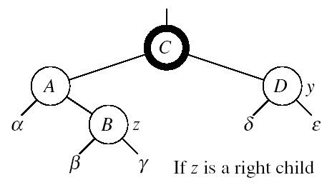
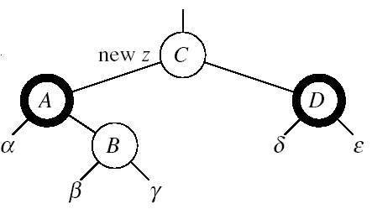
RB-INSERT-FIXUP – Case 1
z’s “uncle” (y) is red.
Idea: (z is a right child)
p[p[z]] (z’s grandparent) must be black: z and p[z] are both red.
Color p[z] black.
Color y black.
Color p[p[z]] red.
  Push the “red” violation up the tree
  Make z = p[p[z]].

Slide 41
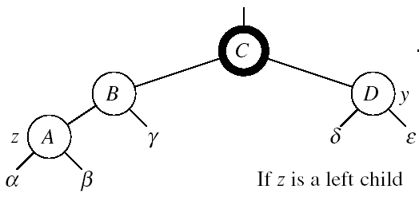
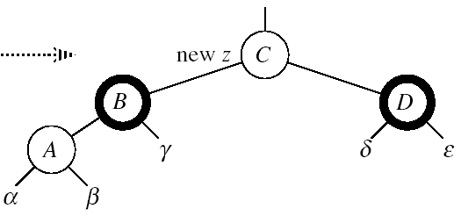
RB-INSERT-FIXUP – Case 1
z’s “uncle” (y) is red.
Idea: (z is a left child)
p[p[z]] (z’s grandparent) must be black: z and p[z] are both red.
color[p[z]] ← black.
color[y] ← black.
color p[p[z]] ← red.
z = p[p[z]].
  Push the “red” violation up the tree.
Case 1

Slide 42
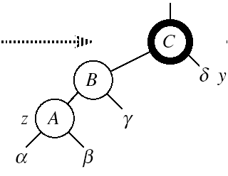
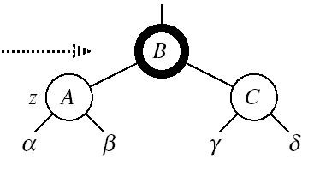
RB-INSERT-FIXUP – Case 3
Case 3:
z’s “uncle” (y) is black.
z is a left child.
Idea:
color[p[z]] ← black.
color[p[p[z]]] ← red.
RIGHT-ROTATE(T, p[p[z]]).
No longer have 2 reds in a row.
p[z] is now black.
Case 3
Case 3

Slide 43
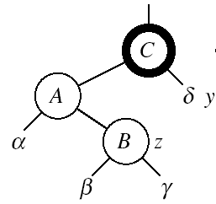
RB-INSERT-FIXUP – Case 2
Case 2:
z’s “uncle” (y) is black.
z is a right child.
Idea:
z ← p[z].
LEFT-ROTATE(T, z).
⇒ now z is a left child, and both z and p[z] are red ⇒ Case 3.
Case 2
Case 2
Case 3

Slide 44
RB-INSERT-FIXUP(T, z)
while color[p[z]] = RED do
if p[z] = left[p[p[z]]]
then y ← right[p[p[z]]]
if color[y] = RED
then Case 1
else if z = right[p[z]]
then Case 2
else Case 3
else (same as then clause with “right” and “left” exchanged)
color[root[T]] ← BLACK
The while loop repeats only when
Case 1 is executed: O(lg n) times
Set the value of x’s “uncle”
We just inserted the root, or
The red violation reached the root.

Slide 45
Example
Insert 4
11
Case 1
11
Case 2
2
14
2
14
y
1
7
7
z
15
1
15
5
8
y
5
8
z and p[z] are both red
z’s uncle y is red
z and p[z] are both red
z’s uncle y is black
z is a right child
z
4
4
11
7
Case 3
z
7
14
y
2
11
z
2
8
15
1
5
8
14
1
5
z and p[z] are red
z’s uncle y is black
z is a left child
4
15
4

Slide 46
Analysis of RB-INSERT
Inserting the new element into the tree O(lg n).
RB-INSERT-FIXUP
  The while loop repeats only if CASE 1 is executed.
  The number of times the while loop can be executed is O(lg n).
Total running time of RB-INSERT: O(lg n).

Slide 47
Red-black trees - summary
Operations on red-black trees:
  SEARCH O(h)
  PREDECESSOR O(h)
  SUCCESOR O(h)
  MINIMUM O(h)
  MAXIMUM O(h)
  INSERT O(h)
  DELETE O(h)
Red-black trees guarantee that the height of the tree will be O(lg n).

Slide 48
Wrap-up
Determining the complexity of algorithms is usually the first step in obtaining better algorithms.
  Or realizing we cannot do any better.
What should you know?
  Properties of red-black trees.
  Proofs for red-black trees.
  Operations on red-black trees.
  Exploiting invariants and recursive structures in proofs.

